Slide 1
Physical Chemistry
Jun Hu
(胡 军)
021-64252630
junhu@ecust.edu.cn
Bilingual Program
版权所有：华东理工大学物理化学教研室

Slide 2
Preface
Physical chemistry is the branch of chemistry that develops principles of the subject. By employing theoretical and experimental methods of physics and mathematics, It studies the principles of equilibria and rates in chemical reaction including phase and pVT changes, and the relations between the principles and the microscopic structure of the substance.

Slide 3
Framework for studying principles of equilibria and rates
Principles of Equilibria
Principles of Rates
Theoretical Methods
Theoretical Methods
General Principles
Characteristics of Substance
Characteristics of Substance
General Principles
Macroscopic
Level
pVT relations
Thermal properties
Non-idealities
Interfacial properties
Electrode properties
Experimental Measurements
Chemical Thermodynamics
Empirical and Semi-Empirical Methods
Transport properties
Reaction properties
Transport and Chemical Kinetics
Theoretical Methods
Theoretical Methods
General Principles
Characteristics of Substance
Characteristics of Substance
General Principles
Transition Level
from Microscopic to Macroscopic
Experimental Measurements
Statistical Thermodynamics
Molecular structures Molecular energy levels
Intermolecular forces
Empirical and Semi-Empirical Methods
Molecular structures Molecular energy levels
Intermolecular forces
Potential surface
Statistical Mechanics
Theoretical Methods
Theoretical Methods
General Principles
Characteristics of Substance
Characteristics of Substance
General Principles
Microscopic
Level
Quantum Mechanics
Particle masses
Particle changes
Particle masses
Particle changes
Quantum Mechanics

Slide 4
Rate
Ch.6 Transport Phenomena
Ch.7 Chemical Kinetics
Ch.8 Kinetics of Various types of Chemical Reactions

Slide 5
Part II: Rate
Ch. 7 Chemical Kinetics
Bilingual Program
版权所有：华东理工大学物理化学教研室

Slide 6
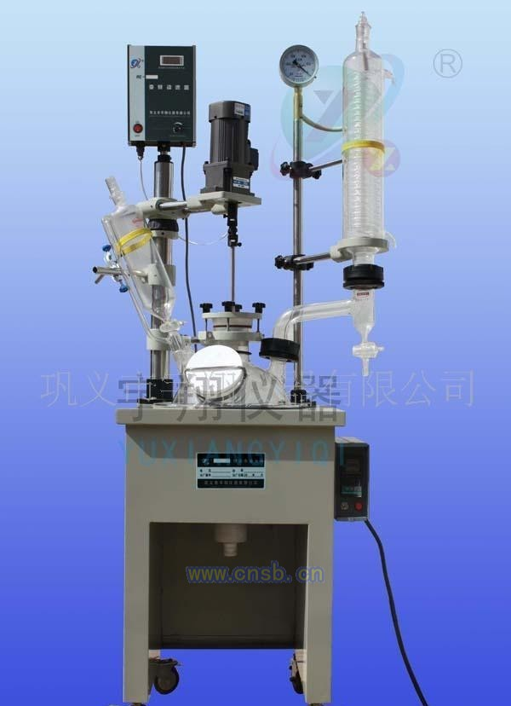
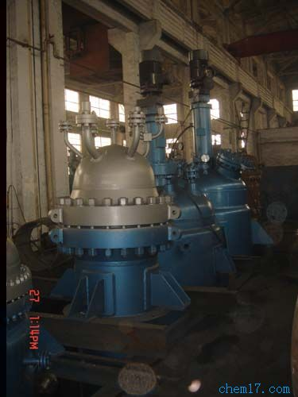
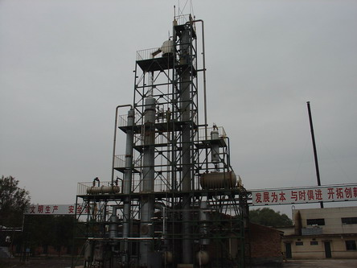
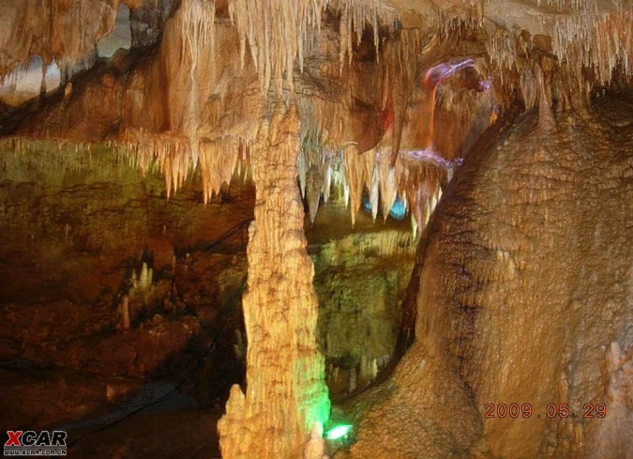
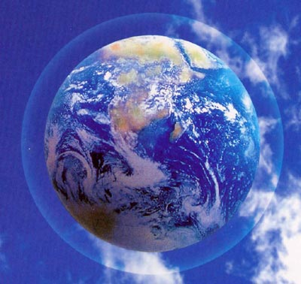
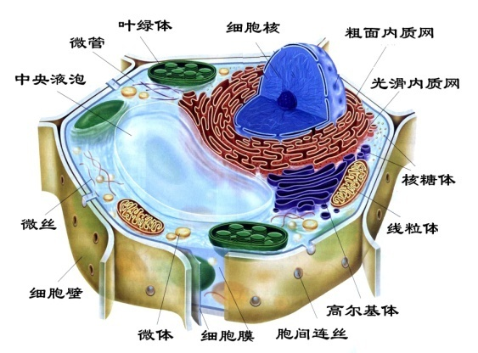
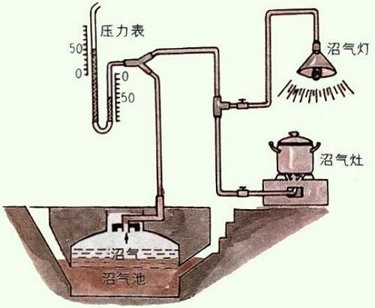
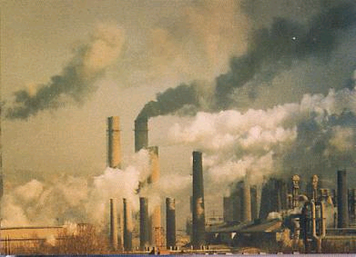

Slide 7
Framework of the Chapter
Principles of Rates on macroscopic level
General Principles
Chemical kinetics,
Rate equations,
Arrhenius equation…
Characteristics
Reaction constant,
Reaction order,
Activation energy…
Effects of the various
conditions on
Chemical kinetics
Experimental methods
Semi-Empirical methods
Theoretical methods
Concentration,
Temperature and Pressure,
Special field such as light, electric, magnetic, plasma…

Slide 8
7. Chemical Kinetics
Framework of the Chapter
  7.1 Introduction
  I. Fundamental Principles of Chemical Kinetics
  7.2 Rates of Chemical Reactions
  7.3 Reaction-Rate Equations
  7.4 Integrated Reaction-Rate Equations
  7.5 Opposite Reactions
  7.6 Consecutive Reactions
  7.7 Parallel Reactions
  7.8 Effect of Temperature on Reaction Rates
  II. Characteristic Parameters in Chemical Kinetics
  7.9 Experimental Methods in Chemical Kinetics
  7.10 Data Processing in Chemical Kinetics
  7.11 Experimental Methods for Rapid Reactions
  7.12 Semi-Empirical Methods
  III. Reaction Mechanisms
  7.13 Reaction Mechanisms and Rate Equations
  7.14 Mono-Molecular Reactions
  7.15 Principles of Microscopic Reversibility and Detailed Equilibrium

Slide 9
7.1 Introduction
Elementary Reactions
Products are formed by only one single step, no intermediates can be detected by macroscopic experimental methods
Complex Reactions
A reaction composed of two or more elementary reactions
Reaction Mechanisms
Pattern or sequence of elementary reactions in composing a complex reaction
Prediction the rate of a complex reaction by the rates of the corresponding elementary reactions.
Determinations needs kinetic experiments and theoretical analysis.
most reaction mechanisms are only reasonable hypotheses.

Slide 10
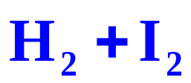



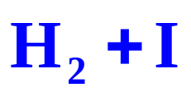

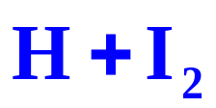

7.1 Introduction
Reaction Mechanisms
Reaction of
is composed by the following elementary reactions
(1)
(2)
(3)

Slide 11
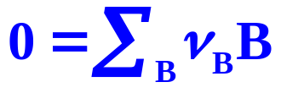
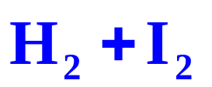
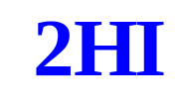
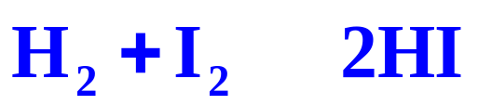
7.1 Introduction
Reaction Formulae and Stoichiometric Equations
Balance of the equation , “ ”
Stress in equilibrium, two half-arrows “ ”
Happens in a single direction, a single arrow “ ”
Interested in both the forward and reverse, two arrows “ ”
An elementary equation, a single full arrow “ ”

Slide 12
I.
Fundamental Principles of Chemical Kinetics
Bilingual Program
版权所有：华东理工大学物理化学教研室

Slide 13
7. Chemical Kinetics
  I. Fundamental Principles of Chemical Kinetics
  7.2 Rates of Chemical Reactions
  7.3 Reaction-Rate Equations
  7.4 Integrated Reaction-Rate Equations
  7.5 Opposite Reactions
  7.6 Consecutive Reactions
  7.7 Parallel Reactions
  7.8 Effect of Temperature on Reaction Rates

Slide 14
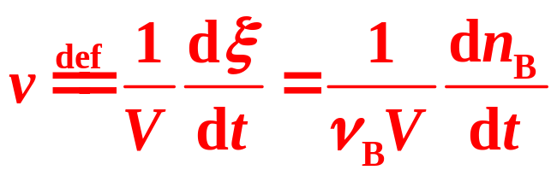
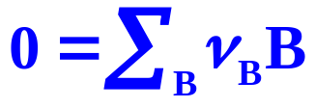

  7.2 Rates of Chemical Reactions
Reaction Rate, Time and Space
The reaction rate is defined as:
The variation of the amount of a reactant or a product in a unit time and in a unit space.
The rate of change of the amount of a reactant or a product in a unit space.
Reaction Rate v
the reaction extent ξ

Slide 15
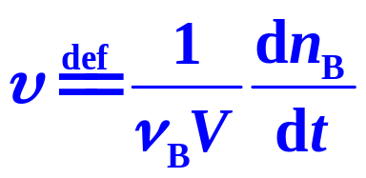
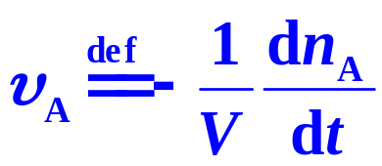
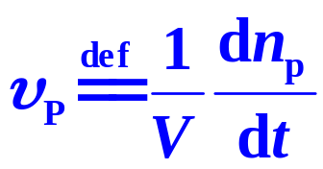
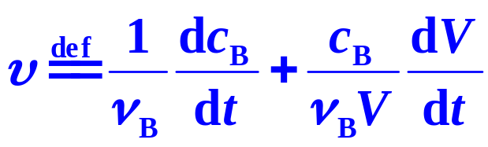
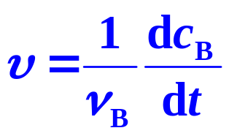
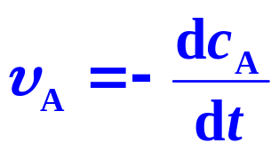
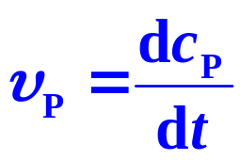
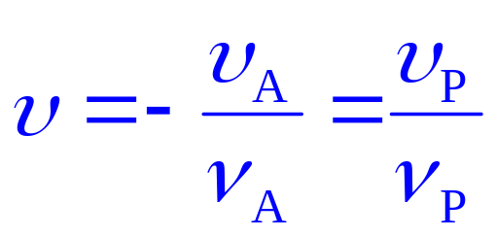
  7.2 Rates of Chemical Reactions
Reaction Rate
Rate of
Consumption
Rate of
Formation
(V constant)
(V constant)
(V constant)

Slide 16

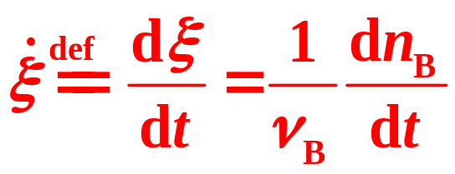
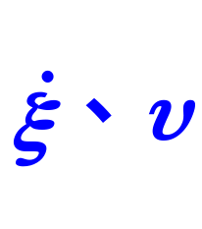
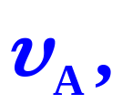

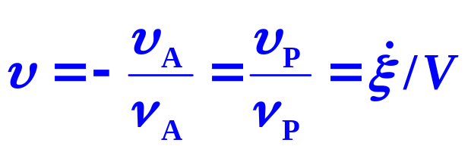

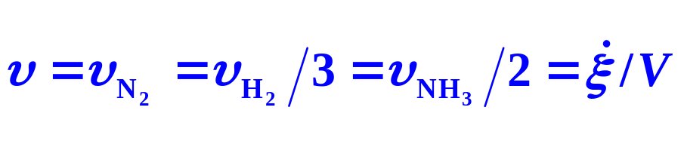
  7.2 Rates of Chemical Reactions
Rate of Conversion
Mutual Relations of Various Rates
—— independent of the selection of the substance
—— dependent of the selection of the substance
For the reaction of

Slide 17
7. Chemical Kinetics
  I. Fundamental Principles of Chemical Kinetics
  7.2 Rates of Chemical Reactions
  7.3 Reaction-Rate Equations
  7.4 Integrated Reaction-Rate Equations
  7.5 Opposite Reactions
  7.6 Consecutive Reactions
  7.7 Parallel Reactions
  7.8 Effect of Temperature on Reaction Rates

Slide 18
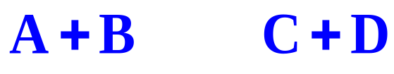
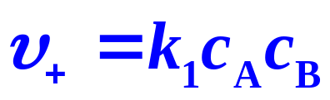
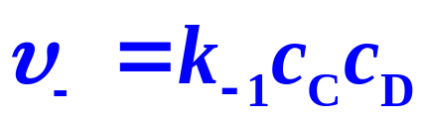
  7.3 Reaction-Rate Equations
Reaction-Rate Equations ( Kinetic Equations)
The mathematical equations quantitatively describing the effect of concentrations of various substances on reaction rates when fixing the other factors.
Reaction-rate equations are irrelevant to the types and the sizes of the reactors.
Mass Action Law
(Waage P and Guldberg C M in 1867)
Reaction rate is proportional to the power product of concentrations of various reactants.

Slide 19






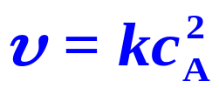
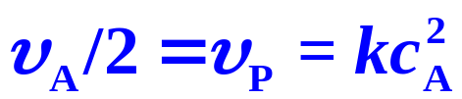


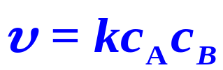


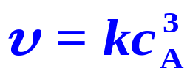
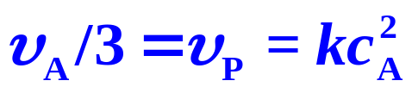



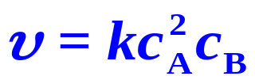
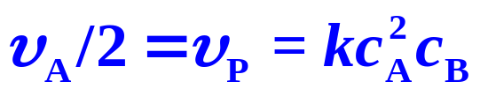


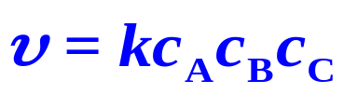
  7.3 Reaction-Rate Equations
1. Elementary Reactions
Consumption (Formation) Rate
Reaction type
Reaction rate
Unimolecular Reactions
Bimolecular Reactions
Trimolecular Reactions

Slide 20
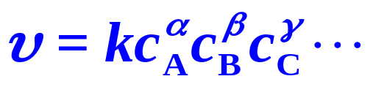
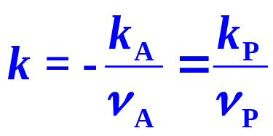
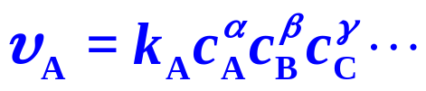
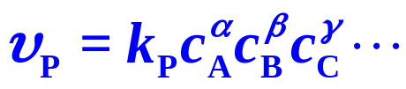
  7.3 Reaction-Rate Equations
2. Complex Reactions
Empirical Rate Equations
Theoretical Rate Equations
(1) Rate Equations of Power-Function Type
Where, k — Rate Constant, depending on the temperature
α, β, γ , — Partial Orders, the extents of influence of the substances on the reaction rate. They could be positive and negative, integers or non-integers.
n = α + β + γ +… , — Reaction Orders, The corresponding reaction is called a n^{th} -order reaction

Slide 21
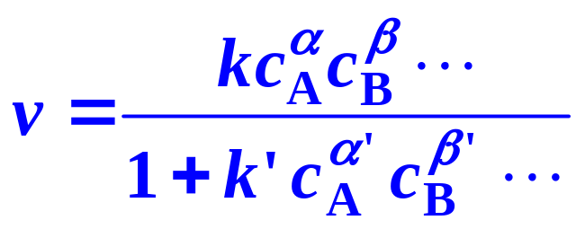
  7.3 Reaction-Rate Equations
2. Complex Reactions
(2) Rate Equations of Non-Power-Function Type
This type of equations always indicates a complex reaction mechanism

Slide 22
7. Chemical Kinetics
  I. Fundamental Principles of Chemical Kinetics
  7.2 Rates of Chemical Reactions
  7.3 Reaction-Rate Equations
  7.4 Integrated Reaction-Rate Equations
  7.5 Opposite Reactions
  7.6 Consecutive Reactions
  7.7 Parallel Reactions
  7.8 Effect of Temperature on Reaction Rates

Slide 23
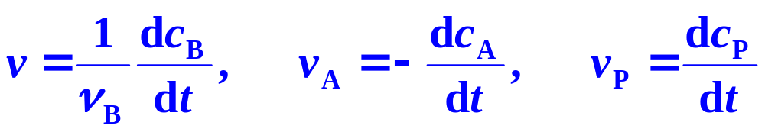
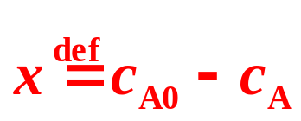
  7.4 Integrated Reaction-Rate Equations
Integrated reaction-rate equations.
The relations for the change of concentrations with time.
Depends on the type of the reactor
Batch Reactor To feed reactants only once then to obtain products after reaction at a constant V.
Concentration of Reactant A Consumed at time t
Time=0, c_{A0;} Time = t, c_{A}.
Half life t_{1/2} the time needed to consume one half of the reactant A.

Slide 24
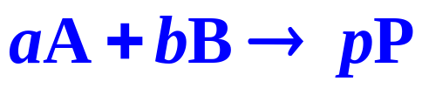
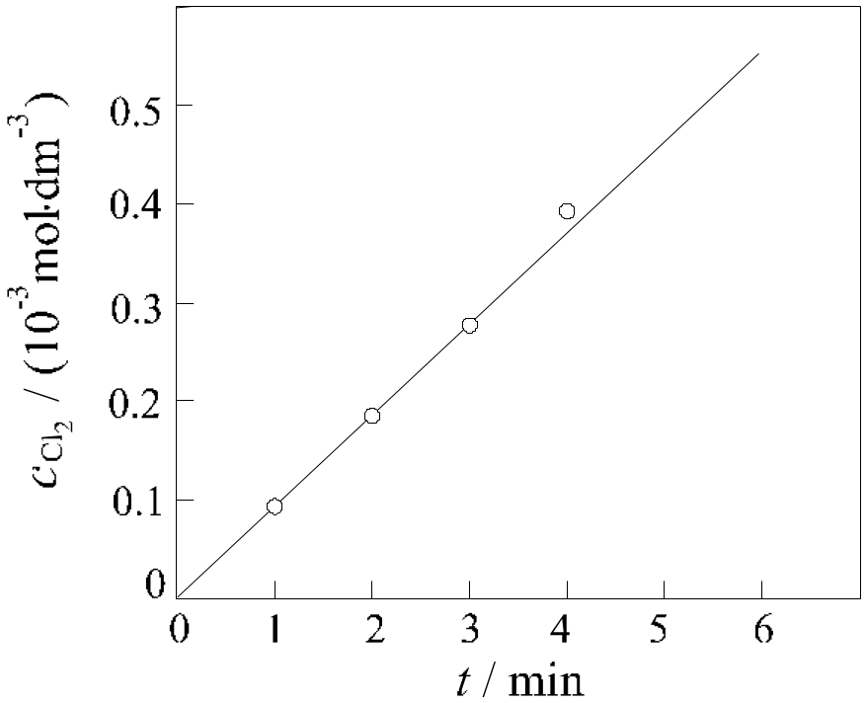



  7.4 Integrated Reaction-Rate Equations
1. Zeroth Order Reactions, n=0
1. Zeroth Order Reactions, n=0
Rate Equation
Rate Equation
Integrated Rate Equation
Variation of c_{Cl2} with time
Zeroth order reactions are observed mostly in catalytic reactions and in reactions subject to external fields

Slide 25



  7.4 Integrated Reaction-Rate Equations
1. Zeroth Order Reactions, n=0
Characteristics
The rate is independent of concentrations. Plotting c_{A} against t, a straight line is obtained. k_{A} is the negative value of the slope of the line.
Dimension of k_{A} is NL⁻³T⁻¹, where N, L, T are the dimension symbols of the amount of substance, length and time.
Half life t_{1/2} is proportional to the initial concentration c_{A0} and inversely proportional to k_{A}.

Slide 26



  7.4 Integrated Reaction-Rate Equations
2. First Order Reactions, n=1
Rate Equation
Integrated Rate Equation

Slide 27



  7.4 Integrated Reaction-Rate Equations
2. First Order Reactions, n = 1
Characteristics
Plotting ln{c_{A}} against t, a straight line is obtained. k_{A} is the negative value of the slope of the line.
Dimension and unit of k_{A} are T⁻¹ and s⁻¹, respectively. The value of k_{A} is independent of the unit of concentration.
Half life t_{1/2} is inversely proportional to k_{A}, independent of c_{A0}.

Slide 28


  7.4 Integrated Reaction-Rate Equations
2. First Order Reactions, n = 1
The formation of tertiary butyl alcohol reaction
lg{c_{A}}~t for hydration of (CH₃)₃CBr
c_{A}~t for hydration of (CH₃)₃CBr

Slide 29








  7.4 Integrated Reaction-Rate Equations
3. Second Order Reactions, n=2
Rate Equation

Slide 30





  7.4 Integrated Reaction-Rate Equations
3. Second Order Reactions, n=2
Integrated Rate Equation
(A) Rate Equation is

Slide 31


  7.4 Integrated Reaction-Rate Equations
3. Second Order Reactions, n=2
(A) Rate Equation is
Characteristics
Plotting 1/c_{A} against t, a straight line is obtained.
Dimension and unit of k_{A} are L³N⁻¹T⁻¹ and mol^{−1⋅}m³⋅s⁻¹
Half life t_{1/2} is inversely proportional to the product of k_{A} and c_{A0}.

Slide 32









  7.4 Integrated Reaction-Rate Equations
3. Second Order Reactions, n=2
(B) Rate Equation is
(C) Rate Equation is
The characteristics of (B) and (C) are the same as (A)

Slide 33







  7.4 Integrated Reaction-Rate Equations
3. Second Order Reactions, n=2
(D) Rate Equation is
(D) Rate Equation is

Slide 34
  7.4 Integrated Reaction-Rate Equations
3. Second Order Reactions, n=2
(D) Rate Equation is
Characteristics
Plotting against t,
a straight line is obtained.
Dimension and unit of k_{A} are the same as that in the case (A)

Slide 35



  7.4 Integrated Reaction-Rate Equations
3. Second Order Reactions, n=2
(E) Rate Equation is
Integrated Rate Equation

Slide 36





  7.4 Integrated Reaction-Rate Equations
4. nth Order Reactions
Rate Equation
(n≠1)
Integrated Rate Equation
(n≠1)
Characteristics
Plotting against t, a straight line is obtained.
Dimension of k_{A} are L^{3(n-1)}N^{(1-n)}T⁻¹
Half life t_{1/2} is inversely proportional to the product of k_{A} and .

Slide 37
  7.4 Integrated Reaction-Rate Equations
Example
The chemical equation of the conversion of sucrose (A) into glucose and fructose is
Experimental rate equation is v_{A}= k_{A}c_{A}, k_{A}=0.0193min⁻¹, with a concentration of 0.1mol⋅dm⁻³ for the catalyst HCl and a temperature of 48℃. Now we have a sucrose solution with a concentration of 0.200 mol⋅dm⁻³ in a reactor with an effective volume of 2 dm³ reacting at the above condition.
What is the initial rate?
How much glucose and fructose can be obtained after 20 min?
What is the conversion of the sucrose at 20 min?

Slide 38



  7.4 Integrated Reaction-Rate Equations
Solution:
(1) t = 0, c_{A0} = 0.200 mol⋅dm⁻³.
(2) t =20 min
ln(c_{A}/mol⋅dm⁻³) = −0.0193×20 + ln0.200, c_{A} = 0.136 mol⋅dm⁻³
c_{glucose} = c_{fructose}= c_{A0}− c_{A} = (0.200−0.136) = 0.064 mol⋅dm⁻³
V=2dm³, n_{i} =c_{i}V,
n_{glucose}= n_{fructose} = (0.064×2) mol = 0.128 mol.
(3)
, conversion is 32%.

Slide 39
























Summary
aA＋bB →P
Order | Rate equation |  | Characteristics
 | Differential | Integrated | Linear plotting | k_{A} Dimension | Half life t_{1/2}
0
n_{A}=1, n_{B}=0
n_{A}=2, n_{B}=0
n_{A}=1, n_{B}=1 a=b,c_{A0}≠c_{B0}
n_{A}=1, n_{B}=1 a ≠ b,c_{A0}≠c_{B0}
n

